Slide 1





The Future of Design … is online and on-the-go!
Presented by:
Suzy Kendrick
PR Manager
CanvasPop/DNA 11

Slide 2
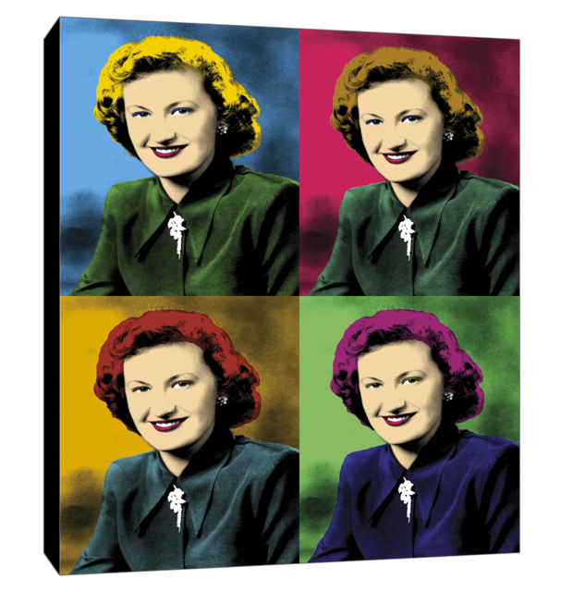
SIMPLICITY
“I believe the future of design will be simple, user-driven and mobile.”
John Katez
Debary, Florida
@johnkatez

Slide 3
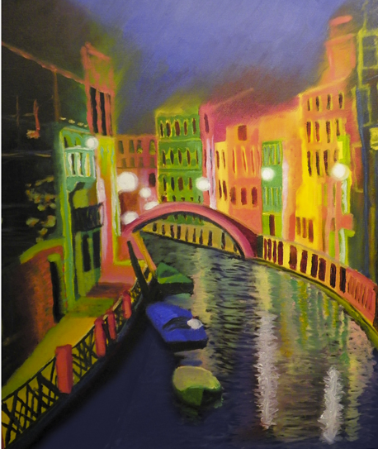
No
“Designer”
Left
Behind
SCOPE
Susan Hicks
Alexandria, Virginia
www.melasdesign.com
“… I get visitors from all over the world, who download my wallpaper everyday. I know it’s not the same as selling artwork in a gallery, but it is rewarding to know that my work is reaching so far.”

Slide 4
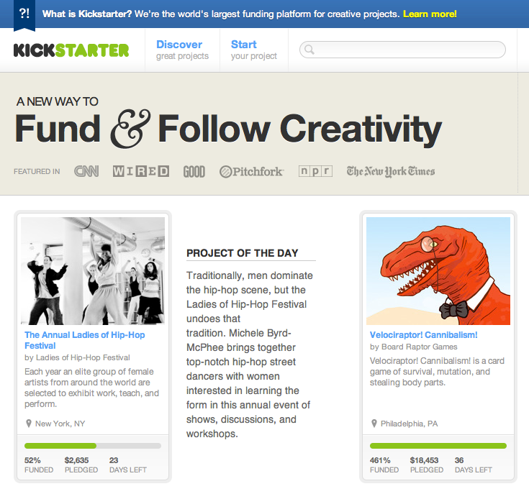
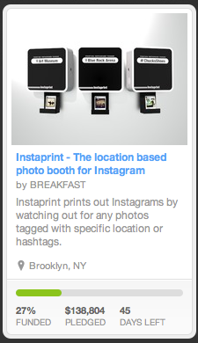
How do we take risks and propel ourselves into the next 100 years of design?
COLLABORATION

Slide 5
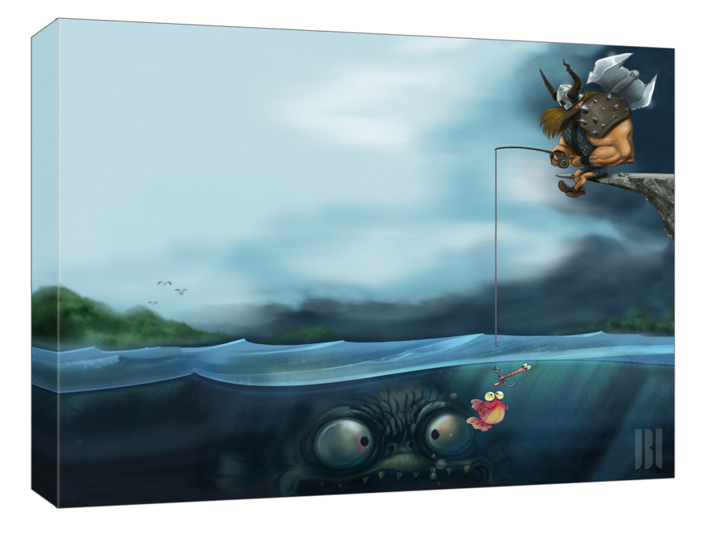
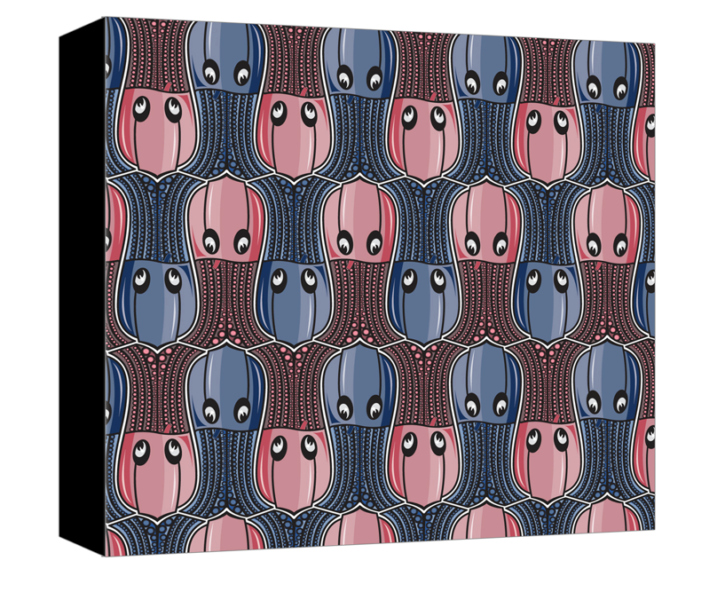
PRO
“I think that there are no more boundaries to our creativity and it's expression.”
Jean – Baptiste Legro
Montreal, Quebec
jblegros.blogspot.ca
CONTROVERSEY
CON
“The internet is a double edged sword in the sense that, while it provide you the ability to share your work with everyone across the globe, it is also a convenient way to plagiarize work.”
Nikita Prokhorov
Bronx, New York
www.ellusvieillusion.com

